Slide 1
The Conveyor Assembly
Alex Chapman

Slide 2
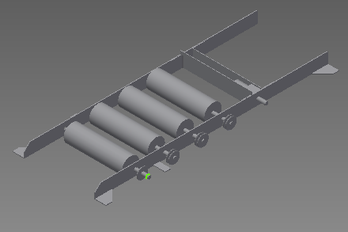
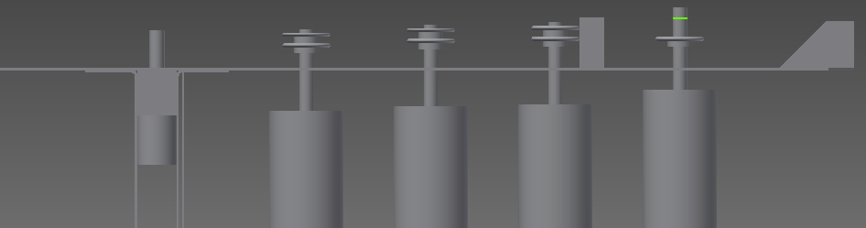
Conveyor Assembly
Chain Drive
#25 Chain
Flanges for structure

Slide 3
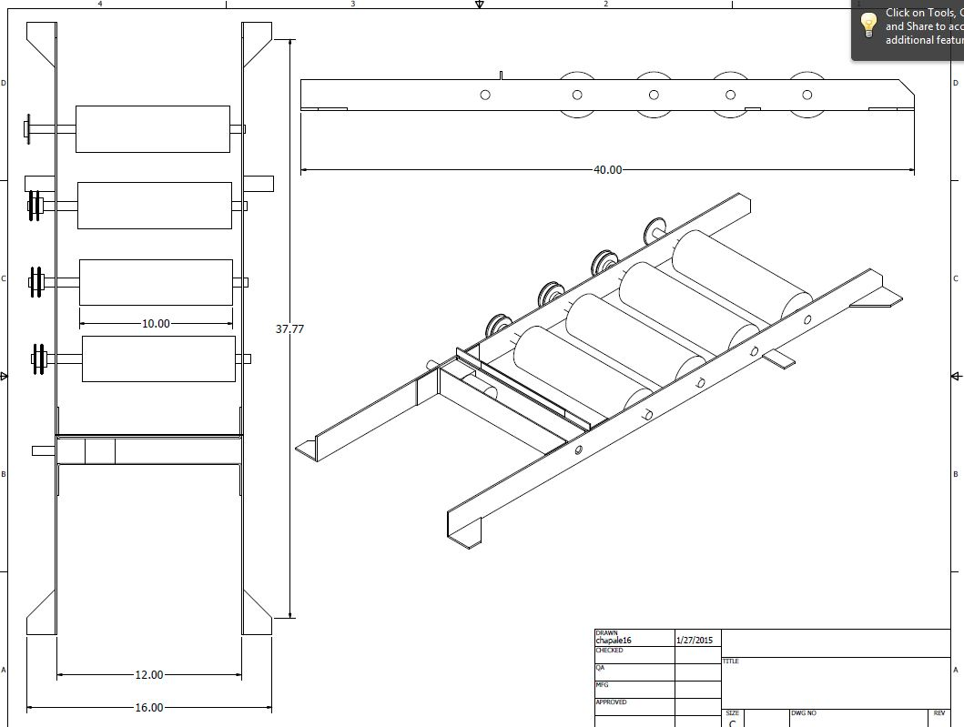

Slide 4
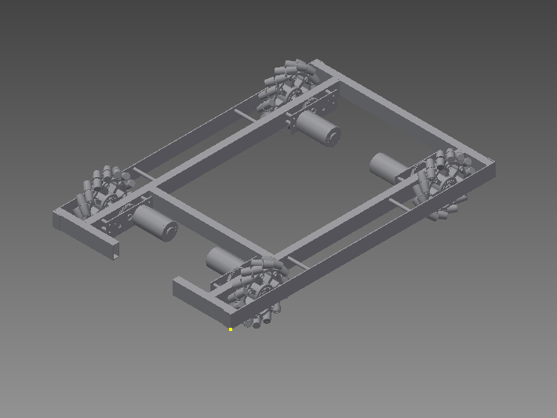
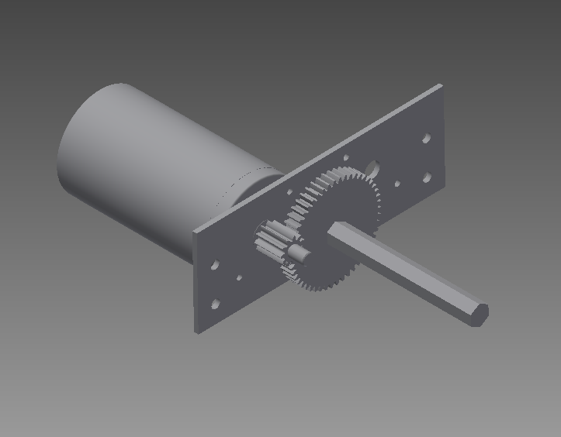
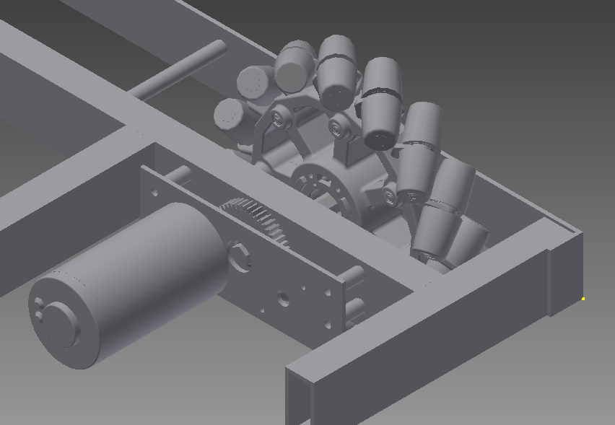
Drive Base
4-Wheel Mechanum Drive
Gearboxes
2x1 boxbeam structure

Slide 5
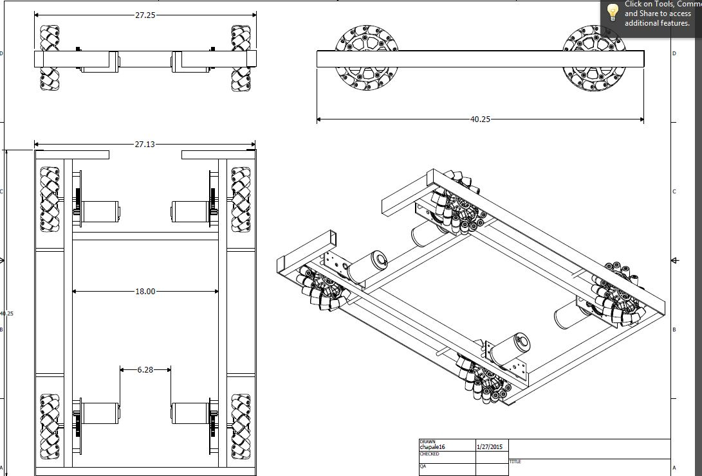

Slide 6
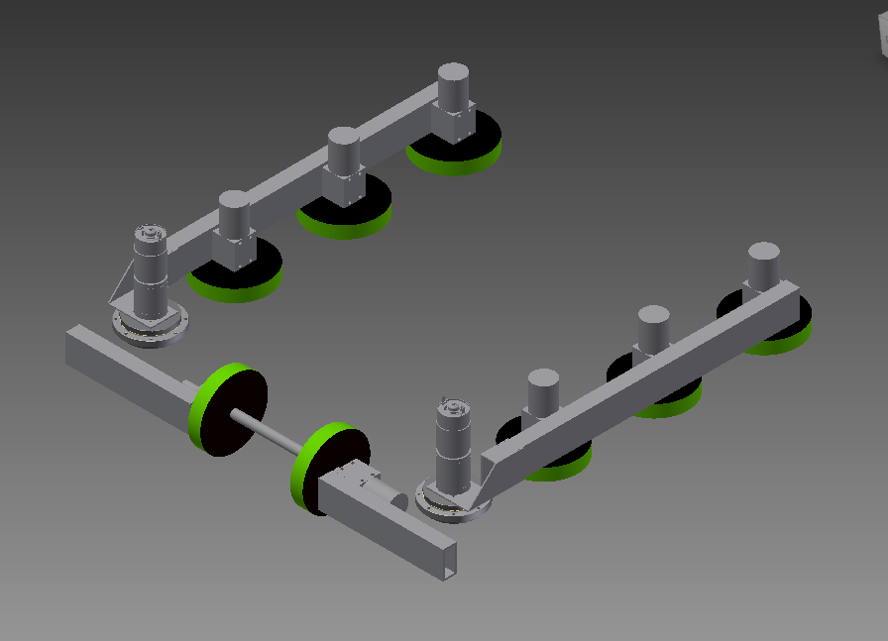
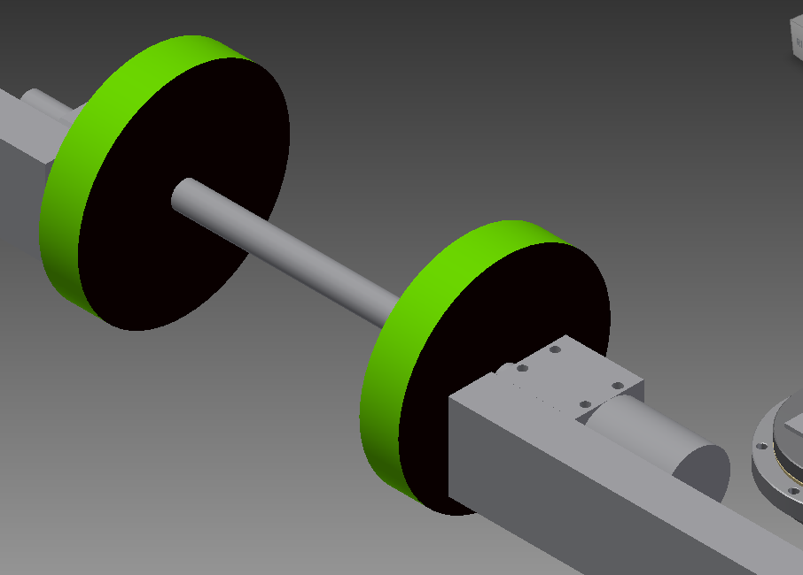
Tote Collector Arms
Motors
Strength
Igus Bearings

Slide 7
